Slide 1






Data Science Intern Challenge
Shopify Fall 2021
Nehel Malhotra

Slide 2
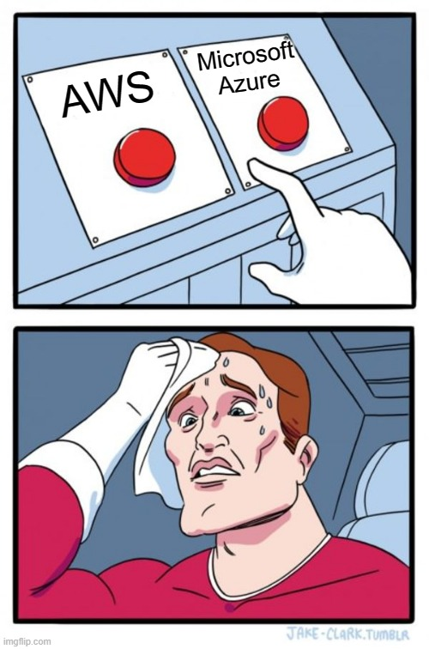
ABOUT ME
Master’s candidate at University of Toronto studying Data Science and Machine Learning.
Enjoy working on things around the house and playing sports like Tennis and Squash.
Firm believer of, a cup of coffee a day keeps the doctor away.

Slide 3
THE MESS UP
As a Project Engineer in my previous role, I was responsible for working with customers to help identify the best solution for their needs.
I designed a tool in Excel to help identify the best suited machine configuration, which we would then quote and build for the customer.
During one such request, I did not factor in a few key material constraints which led to an incorrect configuration.
Once this was identified, I worked with the sales team and the customer to find alternate interim solutions while building a modified assembly.
We ended up selling one of their old used machines in order to make space and efficient use of the pre-built system, while meeting production requirements and delivering the new machine in 4 weeks (average build time of 6 weeks).
A tool is only as good as you make and maintain it.
I set-up bi-weekly review meetings with the process engineers to evaluate and continuously improve the tool.
THE CLEAN
UP
WHAT I LEARNED

Slide 4

MY SHOPIFY STORE
I enjoy gaming and there is a very big gaming community which is looking for new ways to connect with each other.
I decided that gaming merch and clothing can be a great way to introduce yourself as a gamer to the world. This is when I created, Gamer Friendly using Shopify.
The experience of creating my own business was very fulfilling and I really enjoyed working with freelancers to create designs.

Slide 5

01
SECTION 01
Sneaker Store Analysis

Slide 6
HOW CAN SHOPIFY MERCHANTS USE THEIR DATA
MARKETING
CAMPAIGNS
A/B TESTING
Targetted marketing based on demographics.
Design campagins based on customer trends.
Improve customer interaction with the store.
CUSTOMER SATISFACTION
FORECASTING
PROMOTIONS
Personalized emails and relevant content.
Seasonality forecasting.
Compare different channels for promotions.

Slide 7

Metrics to measure performance
01
02
03
04
Average Order Value (AOV)
Top Customers
Average order value for the month.
Customers with the most purchases based on frequency and order amount.
Total Order Value
Repeat Customer Rate
Stores contributing the most and least to total order value.
Proportion of customers who have made at least two purchases.

Slide 8
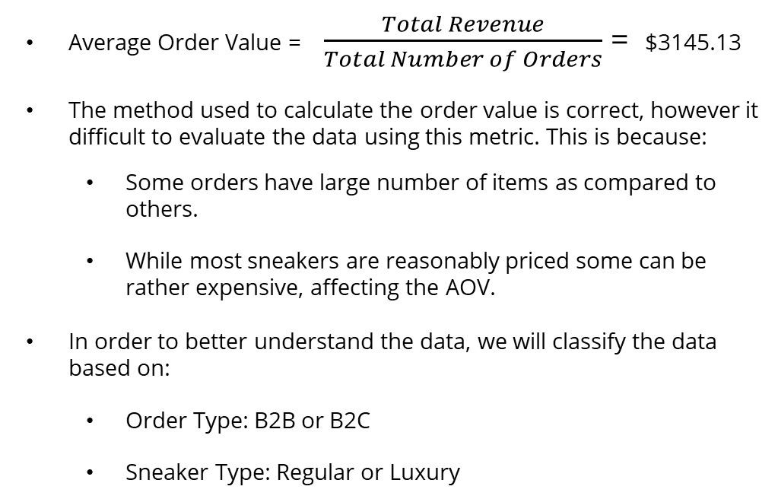
Average Order Value (AOV)
Average Order Value = $\frac{Total Revenue}{Total Number of Orders}$ = $3145.13
The method used to calculate the order value is correct, however it difficult to evaluate the data using this metric. This is because:
Some orders have large number of items as compared to others.
While most sneakers are reasonably priced some can be rather expensive, affecting the AOV.
In order to better understand the data, we will classify the data based on:
Order Type: B2B or B2C
Sneaker Type: Regular or Luxury

Slide 9

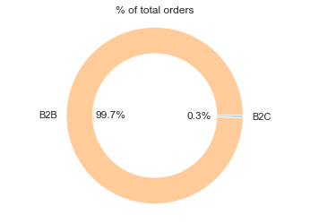
AOV – Order Type
Orders are split based on number of items into B2B and B2C.
A threshold of 50 items is used, which means that we are assuming any order of more than 50 items is likely a sale to another business.
 | AOV
B2C | $754.1
B2B | $70,400

Slide 10
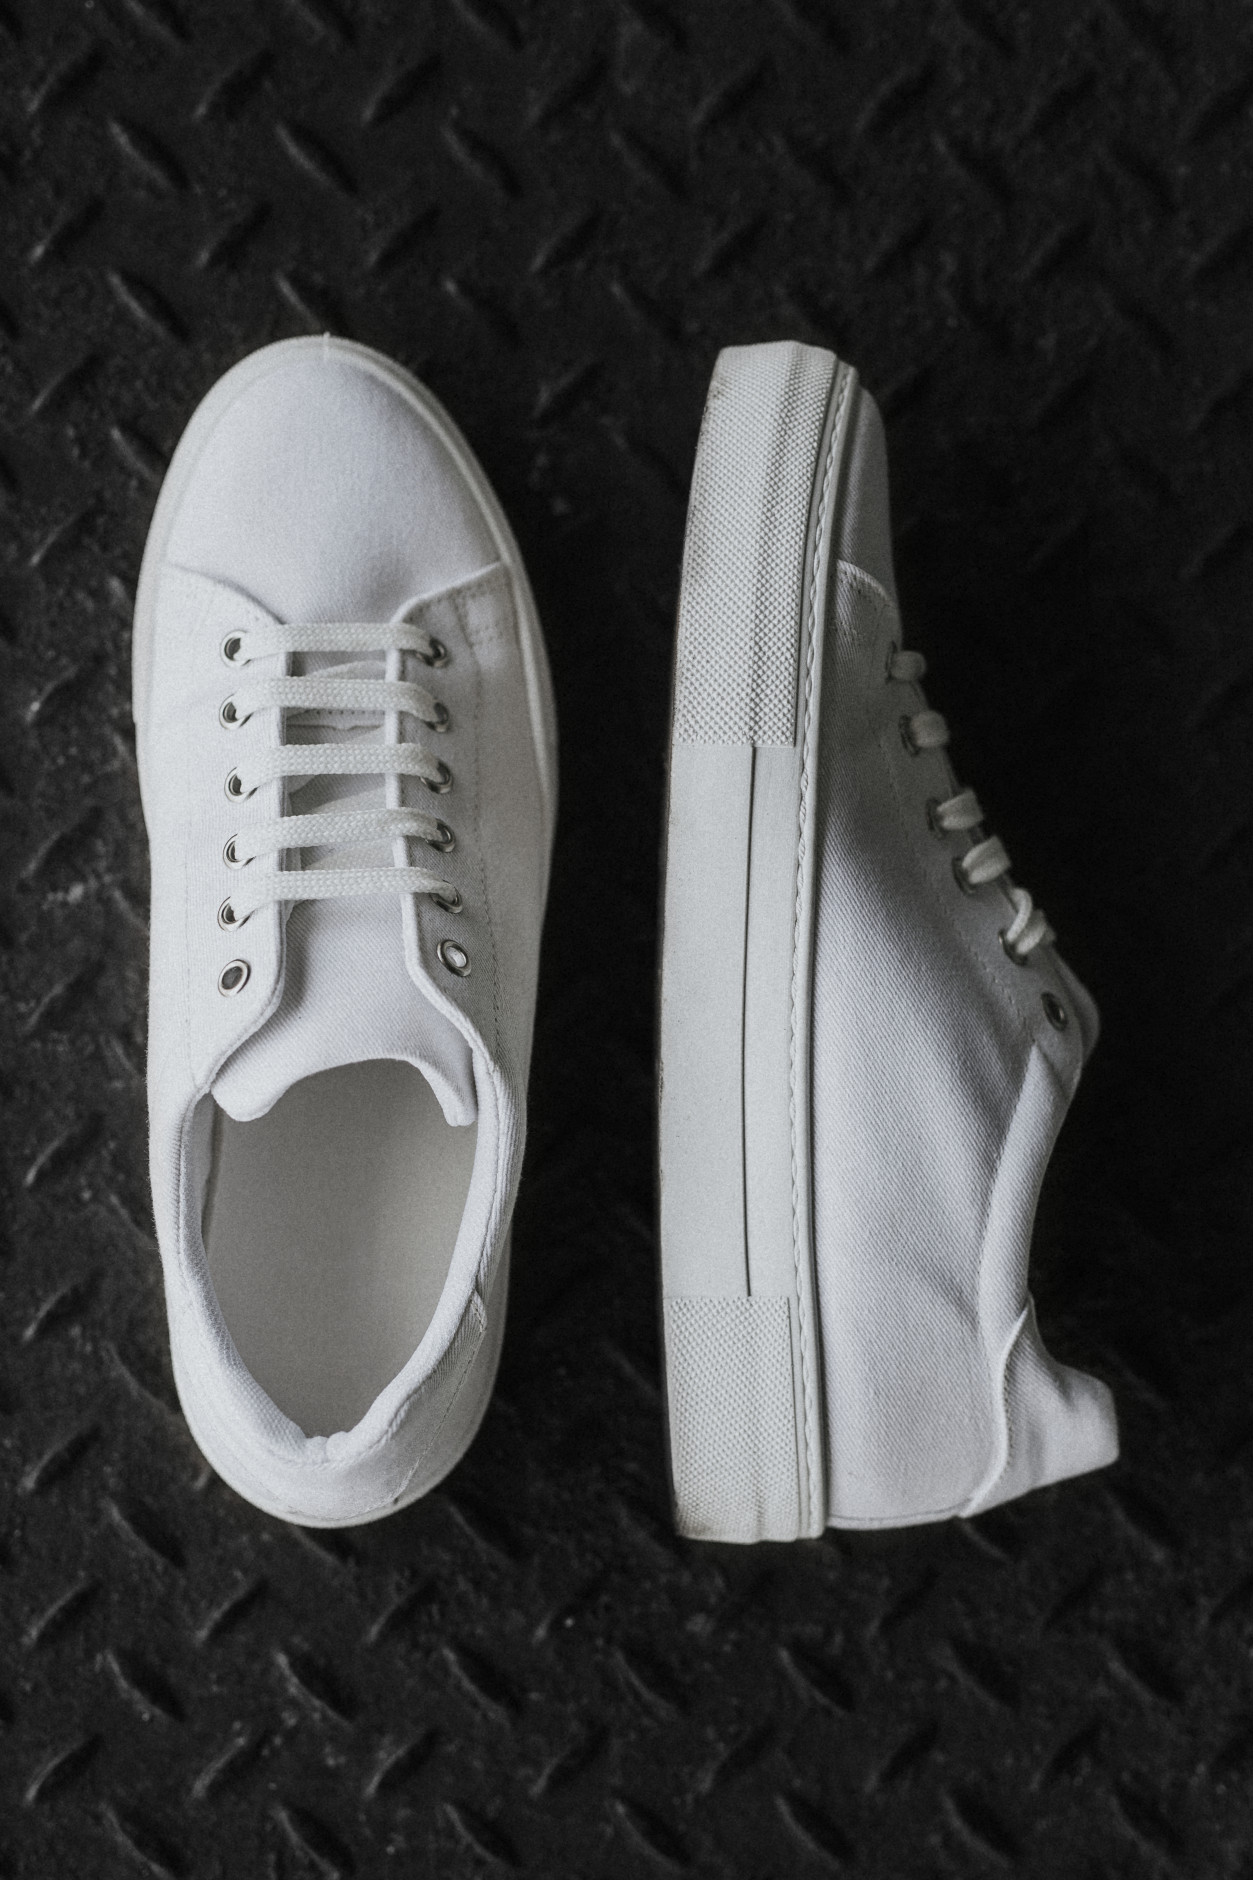
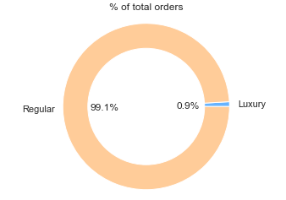
AOV – Sneaker Type
Orders are split based on price of the sneakers.
A threshold of $5,000 / per sneaker is used to classify sneakers into Regular or Luxury.
 | AOV
Regular | $2,717.4
Luxury | $49,213.4

Slide 11

Lets step into the next question..
Further analysis available in the Jupyter Notebook.
Thank you!

Slide 12
02
SECTION 02
SQL Queries

Slide 13
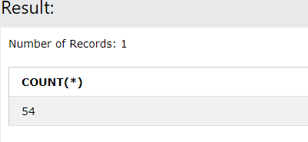
Orders shipped by Speedy Express
SELECT COUNT(*)
FROM Orders
LEFT JOIN Shippers ON Orders.ShipperID = Shippers.ShipperID
WHERE ShipperName = "Speedy Express";

Slide 14
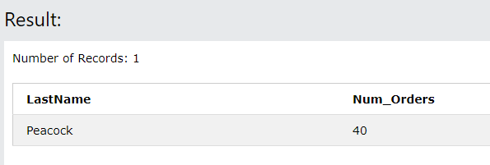
Last name of the employee with most orders
SELECT Employees.LastName, COUNT(*) AS Num_Orders
FROM Orders
LEFT JOIN Employees ON Orders.EmployeeID = Employees.EmployeeID
GROUP BY LastName
ORDER BY Num_Orders DESC
LIMIT 1;

Slide 15
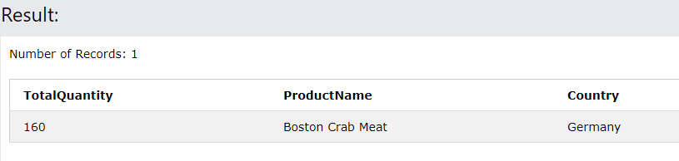
Most popular product in Germany
SELECT SUM(Quantity) AS TotalQuantity, ProductName, Country
FROM OrderDetails
LEFT JOIN Products ON OrderDetails.ProductID = Products.ProductID
LEFT JOIN Orders ON OrderDetails.OrderID = Orders.OrderID
LEFT JOIN Customers ON Orders.CustomerID = Customers.CustomerID
WHERE Country= "Germany“
GROUP BY ProductName
ORDER BY TotalQuantity DESC
LIMIT 1;

Slide 16

THANKS
Please feel free to reach out if you have any questions.

